Slide 1
MongoDB CRUD Operations

Slide 2
CRUD
Create
db.collection.insert( <document> )
db.collection.save( <document> )
db.collection.update( <query>, <update>, { upsert: true } )
Read
db.collection.find( <query>, <projection> )
db.collection.findOne( <query>, <projection> )
Update
db.collection.update( <query>, <update>, <options> )
Delete
db.collection.remove( <query>, <justOne> )

Slide 3
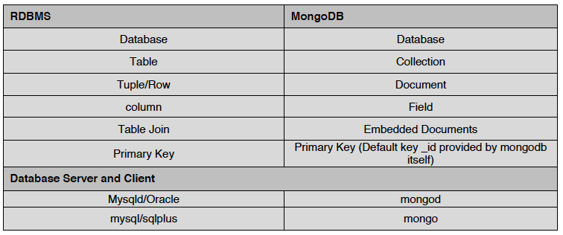
Terms Mapping (DB vs. MongoDB)

Slide 4
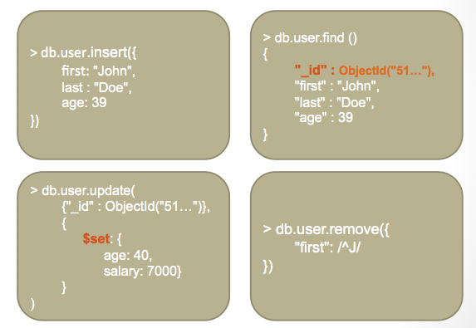
CRUD Examples

Slide 5
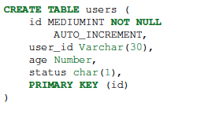


Examples
In RDBMS
In MongoDB
Either insert the 1st docuement
Or create “Users” collection explicitly

Slide 6
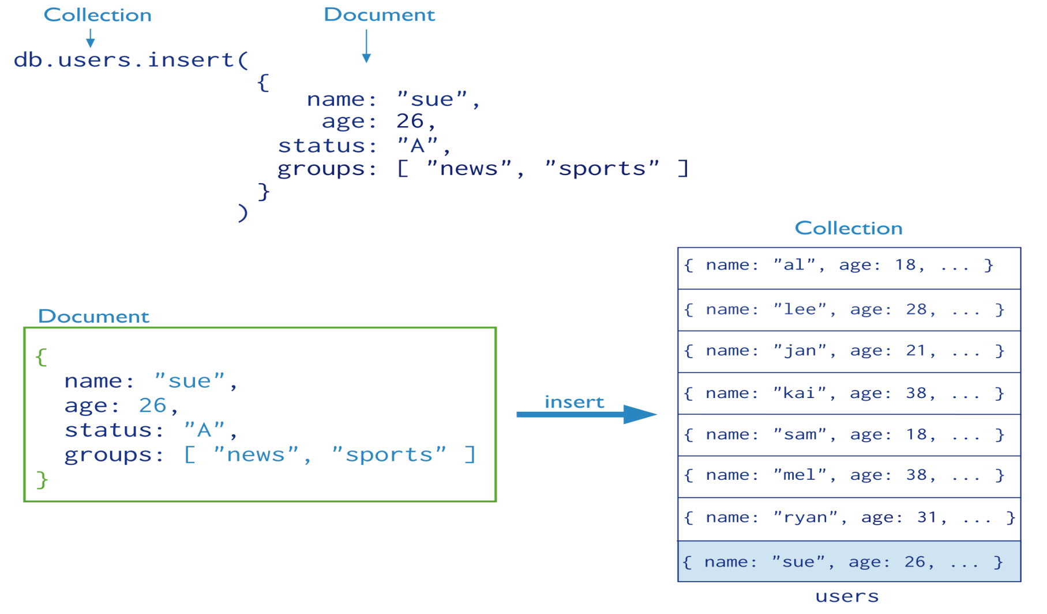
Insertion
The collection “users” is created automatically if it does not exist

Slide 7
Multi-Document Insertion (Use of Arrays)
All the documents are inserted at once

Slide 8
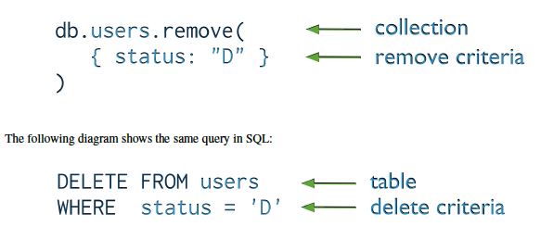
Deletion (Remove Operation)
You can put condition on any field in the document (even _id)
db.users.remove ( )
Removes all documents from users collection

Slide 9
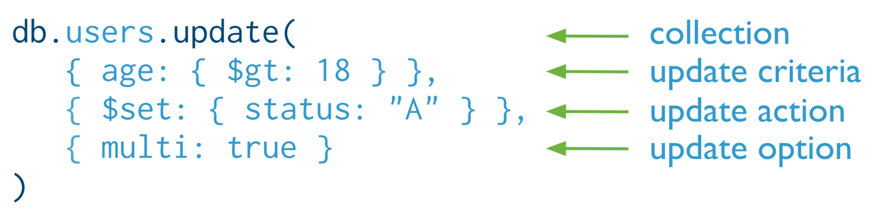

Update
Otherwise, it will update only the 1st matching document
Equivalent to in SQL:

Slide 10
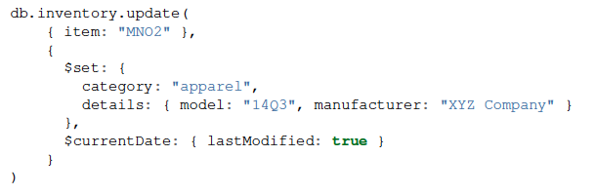
Update (Cont’d)
Two operators

Slide 11
Query Selector Operator
For comparison of different BSON type values:
Name | Description
$eq | Matches values that are equal to a specified value.
$gt | Matches values that are greater than a specified value.
$gte | Matches values that are greater than or equal to a specified value.
$in | Matches any of the values specified in an array.
$lt | Matches values that are less than a specified value.
$lte | Matches values that are less than or equal to a specified value.
$ne | Matches all values that are not equal to a specified value.
$nin | Matches none of the values specified in an array.

Slide 12
$eq
The $eq operator matches documents where the value of a field equals the specified value
Syntax:
{ <field>: { $eq: <value> } }
Example:
db.inventory.find( { qty: { $eq: 20 } } )

Slide 13
$eq
The $ne selects the documents where the value of the field is not equal to the specified value. This includes documents that do not contain the field.
Syntax:
{ <field>: { $ne: <value> } }
Example:
db.inventory.find( { qty: { $ne: 20 } } )

Slide 14
$gt
The $gt selects those documents where the value of the field is greater than (i.e. >) the specified value
Syntax:
{field: {$gt: value} }
Example:
db.inventory.find( { qty: { $gt: 20 } } )

Slide 15
$gte
The $gte selects the documents where the value of the field is greater than or equal to (i.e. >=) a specified value (e.g. value.)
Syntax:
{field: {$gte: value} }
Example:
db.inventory.find( { qty: { $gte: 20 } } )

Slide 16
$in
The $in operator selects the documents where the value of a field equals any value in the specified array.
Syntax:
{ field: { $in: [<value1>, <value2>, ... <valueN> ] } }
Example:
db.inventory.find( { qty: { $in: [ 5, 15 ] } } )

Slide 17
$nin
The $nin selects the documents where:
the field value is not in the specified array or
the field does not exist.
Syntax:
{ field: { $nin: [ <value1>, <value2> ... <valueN> ]} }
Example:
db.inventory.find( { qty: { $nin: [ 5, 15 ] } } )

Slide 18
$lt
The $lt selects the documents where the value of the field is less than (i.e. <) the specified value.
Syntax:
{field: {$lt: value} }
Example:
db.inventory.find( { qty: { $lt: 20 } } )

Slide 19
$lte
The $lte selects the documents where the value of the field is less than or equal to (i.e. <=) the specified value.
Syntax:
{field: {$lte: value} }
Example:
db.inventory.find( { qty: { $lte: 20 } } )

Slide 20
Query Selector Operator
Logical:
Name | Description
$and | Joins query clauses with a logical AND returns all documents that match the conditions of both clauses.
$not | Inverts the effect of a query expression and returns documents that do not match the query expression.
$nor | Joins query clauses with a logical NOR returns all documents that fail to match both clauses.
$or | Joins query clauses with a logical OR returns all documents that match the conditions of either clause.

Slide 21
AND query with Example
{ $and: [ { <expression1> }, { <expression2> } , ... , { <expressionN> } ] }
This query will select all documents in the inventory collection where:
the price field value is not equal to 1.99 and
the price field exists.
db.inventory.find( { $and: [ { price: { $ne: 1.99 } }, { price: { $exists: true } } ] } )

Slide 22
OR query with Example
{ $or: [ { <expression1> }, { <expression2> }, ... , { <expressionN> } ] }
This query will select all documents in the inventory collection where either the quantity field value is less than 20 or the price field value equals 10.
db.inventory.find( { $or: [ { quantity: { $lt: 20 } }, { price: 10 } ] } )

Slide 23
NOT query with Example
{ field: { $not: { <operator-expression> } } }
This query will select all documents in the inventory collection where:
the price field value is less than or equal to 1.99 or
the price field does not exist
db.inventory.find( { price: { $not: { $gt: 1.99 } } } )

Slide 24
NOR query with Example
{ $nor: [ { <expression1> }, { <expression2> }, ... { <expressionN> } ] }
This query will return all documents that:
contain the price field whose value is not equal to 1.99 and contain the sale field whose value is not equal to true or
contain the price field whose value is not equal to 1.99 but do not contain the sale field or
do not contain the price field but contain the sale field whose value is not equal to true or
do not contain the price field and do not contain the sale field
db.inventory.find( { $nor: [ { price: 1.99 }, { sale: true } ] } )

Slide 25
db.collection.save
The db.collection.save() method is used to updates an existing document or inserts a new document, depending on its document parameter
db.collection.save()
Example: db.products.save( { item: "book", qty: 40 } )
db.products.save( { _id: 100, item: "water", qty: 30 } )

Slide 26
db.collection.save
The save() method has the following form:
db.collection.save(
<document>,
{
writeConcern: <document>
}
)
Parameter | Type | Description
document | document | A document to save to the collection.
writeConcern | document | Optional. A document expressing the write concern. Omit to use the default write concern.

